Slide 1
CSE 574 Lecture 4: Adversarial Search
Professor: Stephanie Gil
Email: sgil@asu.edu (Office hours M 12-1pm BYENG 386)
TAs: Sushmita Bhattacharya sbhatt55@asu.edu (Office hours M 5-6 BYENG 392)
Weiying Wang wwang239@asu.edu (Office hours Th 2:30-3:30 BYENG 392)

Slide 2
Pop Quiz Today
This is a closed book quiz. No notes, no phones, no textbook. Please put everything away.
You will have 20 minutes to complete the quiz
Good luck!

Slide 3
Last Time:
Repeated states and how to detect and avoid cycles
Greedy best-first search on trees
A* and its properties
Heuristics and their properties (admissible, consistent)
Graph-search and modifications for A*
This time: Adversarial Search 5.1-5.3 in the Russell and Norvig text

Slide 4
Game Theory
Multiagent environment where the impact of each agent on others is “significant”
Departure from classical planning assumptions
Interactions between agents can be cooperative or competitive. We will focus on competitive.

Slide 5
Assumptions
Deterministic
Turn-taking agents
Two player games
Zero sum games – the utility of agents at the end of the game is always equal and opposite
Perfect information – fully observable environment

Slide 6
We will not cover
Multiplayer games
Non zero-sum games
Stochastic games

Slide 7
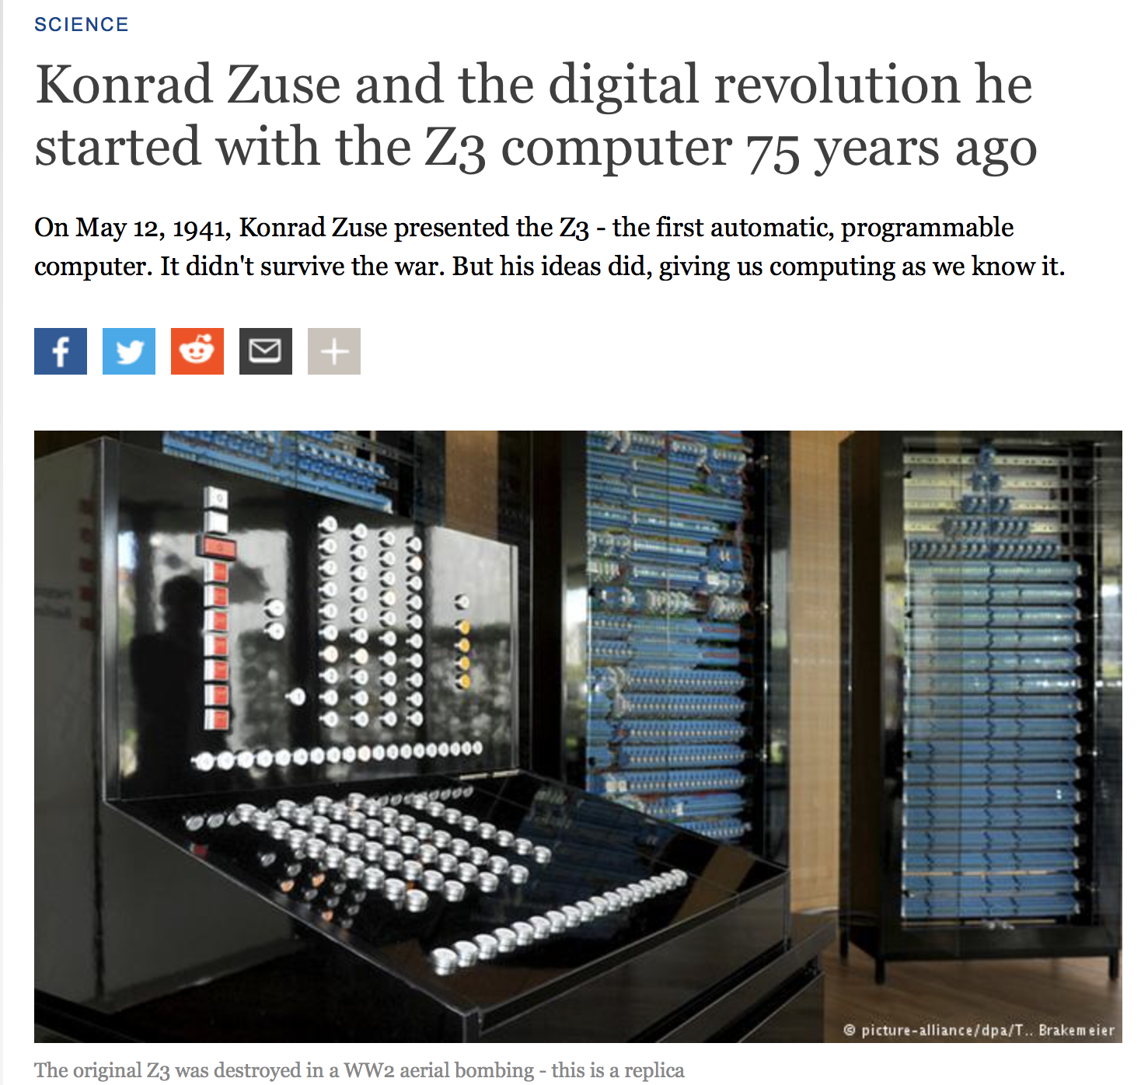
A Bit of History…
Game playing was one of the first tasks undertaken by AI
Notable scientists working on games through history:
Konrad Zuse - the inventor of the first programmable computer and first programming language

Slide 8
A Bit of History…
Game playing was one of the first tasks undertaken by AI
Notable scientists working on games through history:
Konrad Zuse - the inventor of the first programmable computer and first programming language
Claude Shannon – the inventor of information theory
Norbert Weiner – the creator of modern control theory
Alan Turing – widely considered the father of theoretical computer science and artificial intelligence

Slide 9
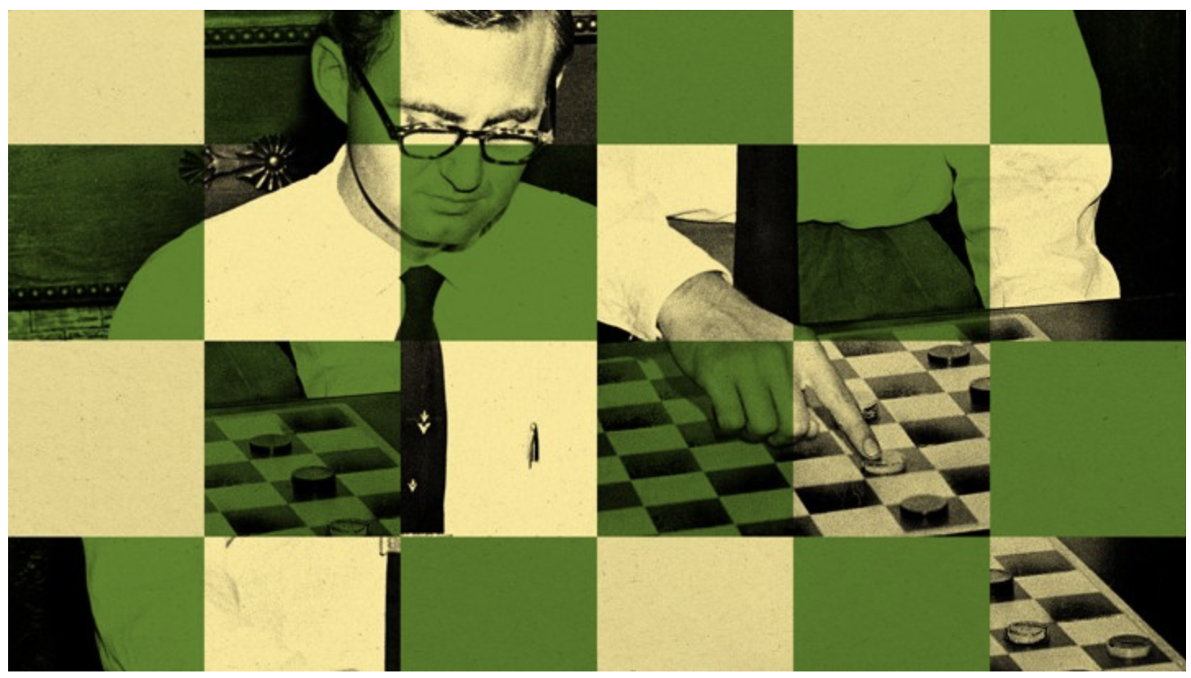
Some Important Games in AI History
Checkers
1994, an AI beat Tinsely, the 40 year undefeated world champion

Slide 10
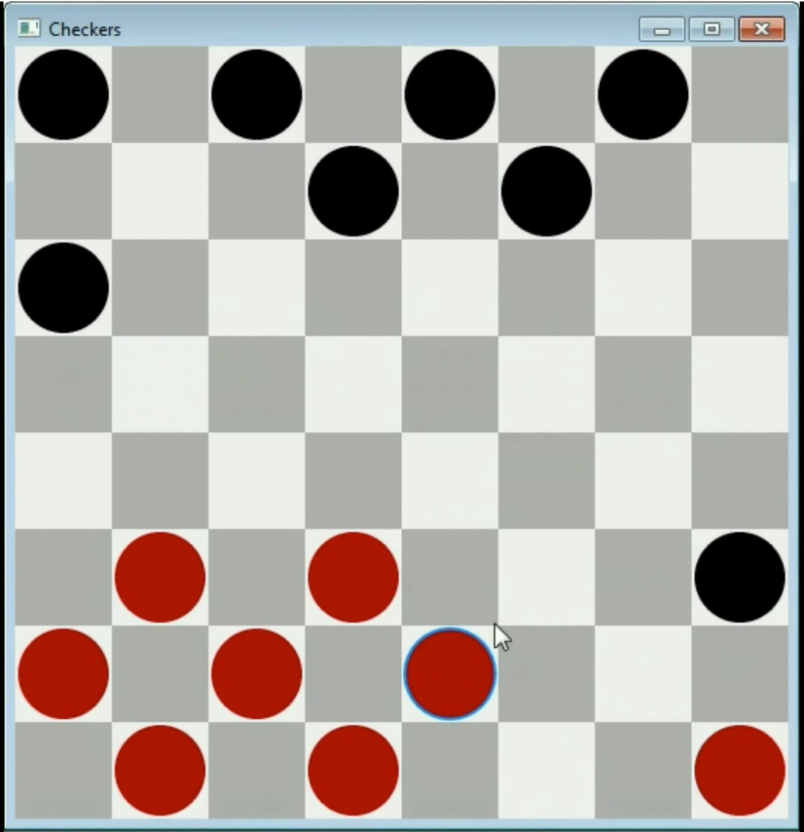
Checkers (cont.)
Size of the
state space: 10⁴⁰
Video credit: youtube with Alpha Beta pruning
Two-player game
If one player wins → opponent loses

Slide 11
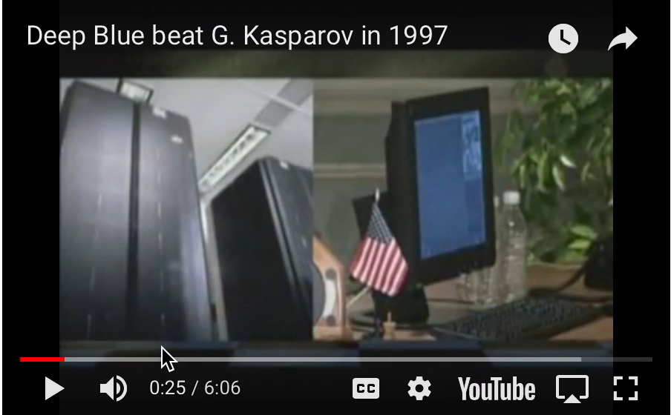
Some Important Games in AI History
Chess
Size of the state space: 10¹⁵⁴
World Champion Kasparov lost to IBM’s Deep Blue in 1997
IBM’s Deep Blue examined 200 million moves every second!

Slide 12
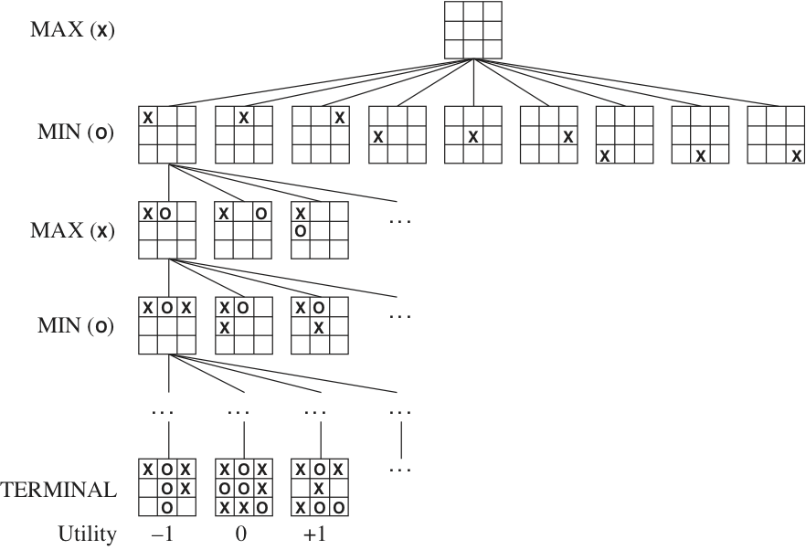
How to “Play”?
State space – all the possible moves
Objective function (or utility value) gives a numeric value for the terminal states
Two players
Example: find the state space and objective function for tic tac toe
Player 1 wants to MAX objective function
Player 2 wants to MIN objective function

Slide 13
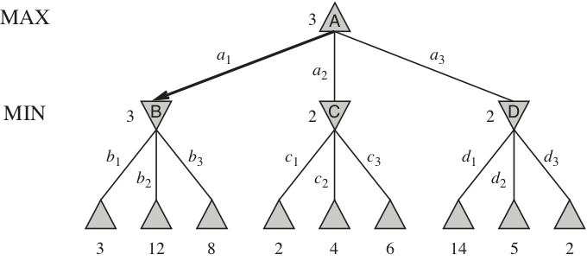
A Game Tree

Slide 14
A Game Tree

Slide 15
A Game Tree

Slide 16
A Game Tree
Say Player 1 (who wants to maximize) plays optimally, then…
What is player 1’s best strategy?
What is player 2’s best response?
Terminal utility of the game

Slide 17
A Game Tree
Say Player 1 (who wants to maximize) does not play optimally, then…
What is player 2’s response?

Slide 18
Minimax Algorithm
Performs a complete depth-first exploration of the game tree
Minimax values are “backed up” to the root
Same time complexity as DFS
Best that player 1 can do if both players are acting optimally

Slide 19
Alpha-Beta Pruning
Recall the importance of pruning…
Checkers 10⁴⁰ state space size
Chess 10¹⁵⁴ state space size
Idea: it is possible to compute the correct minimax decision without looking at every node in the game tree?

Slide 20
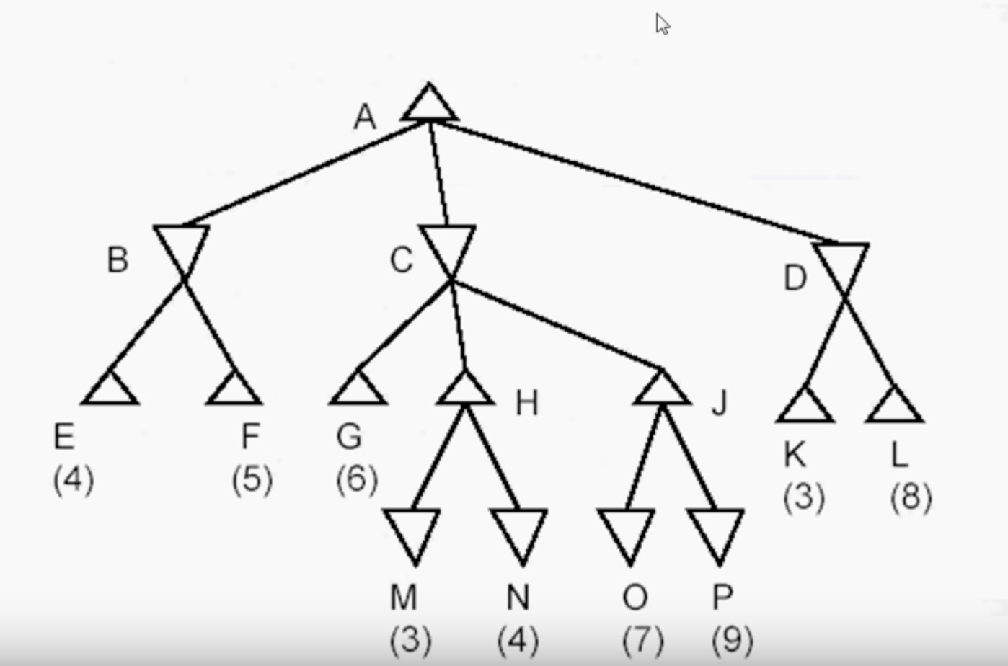
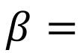
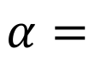
Alpha-Beta Pruning
$$α=$$
the value of the best (i.e. highest-value) choice for player 1 that we have found so far at any choice point along the path
$$β=$$
the value of the best (i.e. lowest-value) choice for player 2 that we have found so far at any choice point along the path
Maximizing player 1
>=4
Rules:
Alternate turns, MAX then MIN
Perform DFS to determine value bound on parent
Examine if the current branch or subtree can improve the bound, if not then cut
<=4
<=4
Minimizing player 2
<=6
>=4
>=3

Slide 21
Next Time…
Constraint Satisfaction Problems (Russell and Norvig ch 6.1-6.4, we may get to 6.5)
New HW out Friday and due in two weeks
Happy Labor Day!

